Slide 1
Topic Modeling
Plate Notation

Slide 2
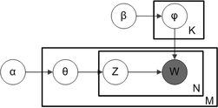
Topic Modeling
LDA (Latent Dirichlet Allocation)

